Slide 1

Unit-2: Wireless Communication Technology PART-1:Cellular Wireless Networks
Mobile Computing Wireless Communication
(MCWC)
GTU # 3170710
Prof.Swati R Sharma
Computer Engineering Department
swati.sharma@darshan.ac.in
(O) 9727747317

Slide 2
Cellular Wireless Networks

Looping
Topics to be covered-Cellular Wireless Networks
Principles of Cellular Networks
First Generation Analog
Second-Generation TDMA
Second-Generation CDMA
Third-Generation Systems

Slide 3
Principles of Cellular Networks

Slide 4
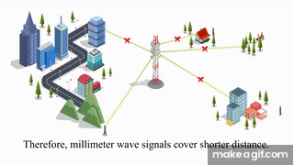
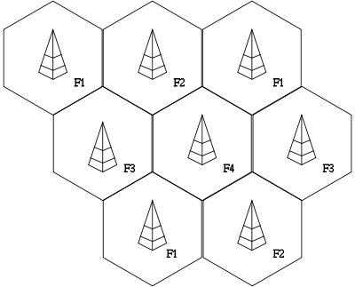
Principles of Cellular Networks
Cellular technology is the foundation of Mobile Wireless Communications.
It support the users in location that are not easily served by wired networks.
Cellular network is an underlying technology for mobile phones, personal communication systems, wireless networking etc.
The technology is developed for mobile radio telephone to replace high power transmitter/receiver systems with low power transmitter/receiver.
Cellular networks use low power, shorter range and more transmitters for data transmission.

Slide 5
Cellular Network Organization

Slide 6
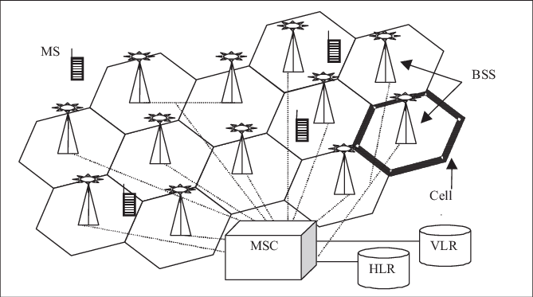
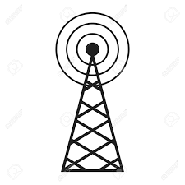
Cellular Network Organization
Multiple low power transmitters
100w or less
Area divided into cells
Each with own antenna
Each with own range of frequencies
Served by Base Station (BS)
Transmitter, receiver, control unit
Adjacent cells on different frequencies to avoid crosstalk
Notes:
MSC:Mobile Switching Centre

Slide 7
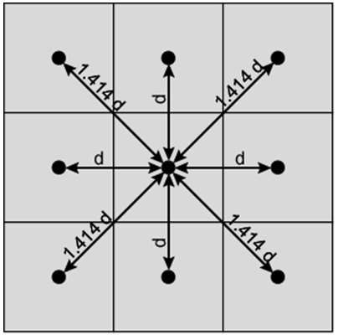
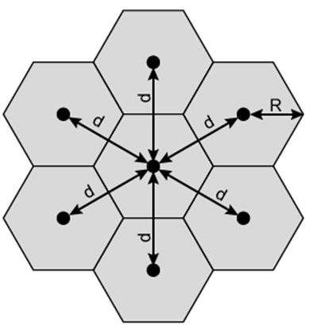
Shape of Cells
Square
Width d cell has four neighbours at distance d and four at distance d
However, this geometry is not ideal
Better if all adjacent antennas equidistant
Simplifies choosing and switching to new antenna
Hexagon
Provides equidistant antennas
Radius defined as radius of circum-circle
Distance from center to vertex equals length of side
Distance between centers of cells radius R is R
Not always precise hexagons
Topographical limitations
Local signal propagation conditions
Location of antennas

Slide 8
Frequency Reuse

Slide 9
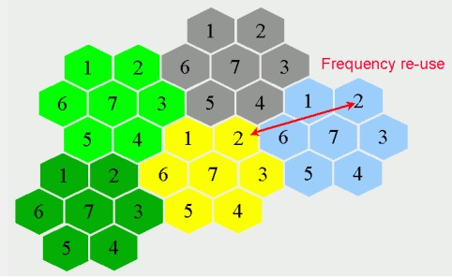
Frequency Reuse
Frequency reusing is the concept of using the same radio frequencies within a given area, that are separated by considerable distance, with minimal interference, to establish communication.
Benefits of Frequency Reuse:
Allows communications within cell on a given frequency
Limits escaping power to adjacent cells
Allows re-use of frequencies in nearby cells
Uses same frequency for multiple conversations

Slide 10
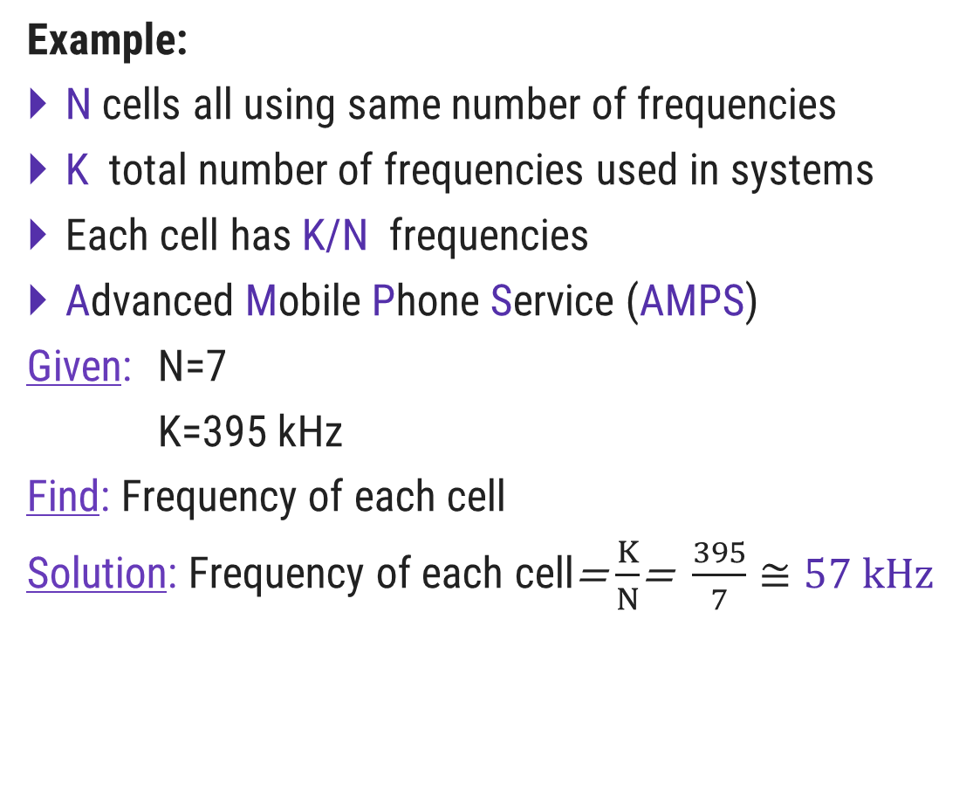
Frequency Reuse
Example:
N cells all using same number of frequencies
K total number of frequencies used in systems
Each cell has K/N frequencies
Advanced Mobile Phone Service (AMPS)
Given: N=7
K=395 kHz
Find: Frequency of each cell
Solution: Frequency of each cell=$\frac{K}{N}$= $\frac{395}{7}≅57 kHz$
2
7
3
1
6
4
5

Slide 11
Characterizing Frequency Reuse
D: Minimum distance between centers of cells that use the same band of frequencies (called co-channels)
R: Radius of a cell
d: Distance between centers of adjacent cells (d = R)
N: Number of cells in repetitious pattern
1
5
2
2
D
7
3
1
R
6
4
d
5

Slide 12
Cluster Size

Slide 13
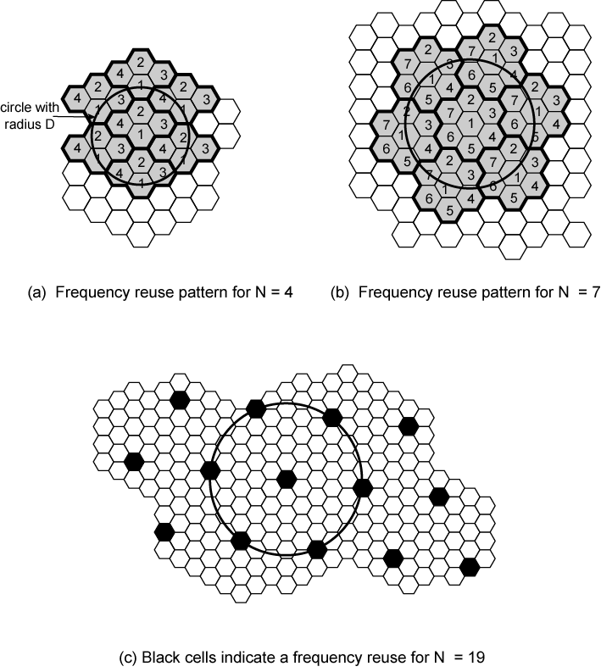
Cluster Size
How to find cluster size of cellular network?

Slide 14
Cluster Size
How to find cluster size of cellular network?
Formula:
N=I²+J²+(I X J)
1
N: | No. of cell with unique/non repeated frequency
5
2
2
7
3
1
6
4
5

Slide 15
Cluster Size
How to find cluster size of cellular network?
Formula:
Now, if we want to find distance to reach from cell1 to another cell1 then,
Given: I=1,J=2
Solution: N=1²+2²+(1X2)
=1+4+2
=7
N=I²+J²+(I X J)
1
j=2
N: | No. of cell with unique/non repeated frequency
5
j=1
I: | No. of steps required to move in one direction in order to reach cell with same frequency
2
2
j=1
i=2
7
i=1
3
J: | No. of steps required to move in other direction(i.e. 60° anticlockwise) in order to reach cell with same frequency.
1
6
i=1
4
5

Slide 16
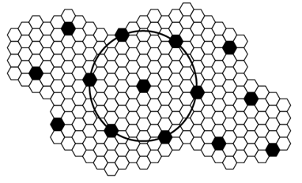
Exercise: Cluster Size
Find cluster size of cellular network.
Formula:
Now, if we want to find distance to reach from cell1 to another cell1 then,
Given: I=2,J=3
Solution: N=2²+3²+(2X3)
=4+9+6
N=19
N=I²+J²+(I X J)

Slide 17
Characterizing Frequency Reuse

Slide 18
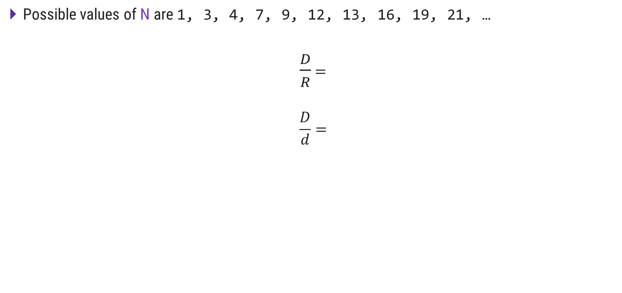
Characterizing Frequency Reuse
Possible values of N are 1, 3, 4, 7, 9, 12, 13, 16, 19, 21, …
$\frac{D}{R}$ $=$
$$\frac{D}{d}=$$
For Hexagonal geometry
Therefore,
1
5
2
D
2
D: Minimum distance between centers of cells that use the same band of frequencies (called co-channels)
R: Radius of a cell
d: Distance between centers of adjacent cells (d = R)
N: Number of cells in repetitious pattern
7
3
1
R
6
4
d
5

Slide 19
Increasing Capacity

Slide 20
Increasing Capacity
As the demand for wireless service increases, the number of channels assigned to a cell eventually becomes insufficient to support the required number of users.
At this point, cellular design techniques are needed to provide more channels per unit coverage area.
Techniques such as
Cell splitting
Cell Sectoring
Coverage zone approaches
are used in practice to expand the capacity of cellular systems.

Slide 21
Cell Splitting

Slide 22
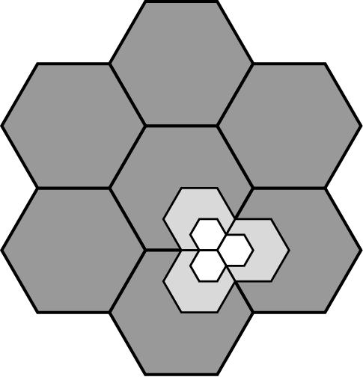
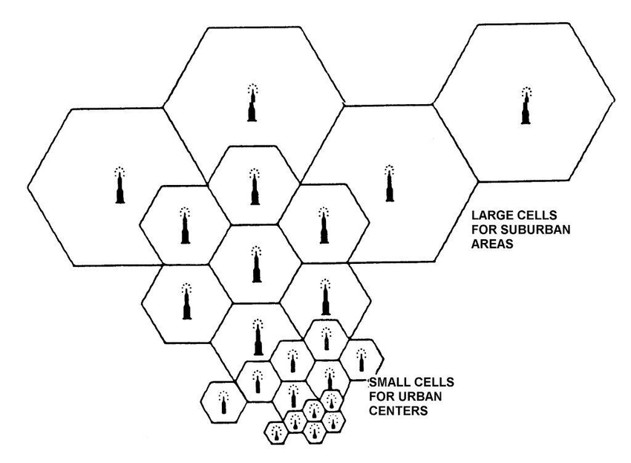
Cell Splitting
Cell splitting is the process of subdividing a congested cell into smaller cells
Each with its own base station and a corresponding reduction in antenna height and transmitter power.
Cell splitting increases the capacity of a cellular system since it increases the number of times that channels are reused.
By defining new cells which have a smaller radius than the original cells and by installing these smaller cells (called microcells) between the existing cells.
Capacity increases due to the additional number of channels per unit area.
The original cell size is about 6.5 to 13km.
To split the cell in smaller cells, the power level must be reduced to keep the signal within cell.
Ideally 1.5Km cells are close to practical minimum size.

Slide 23
Cell Sectoring

Slide 24
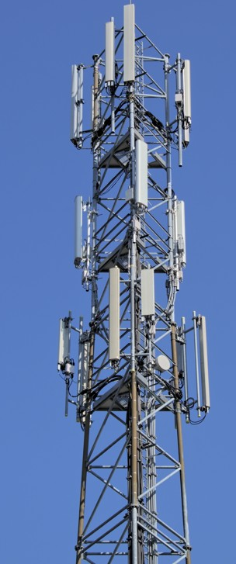
Cell Sectoring
One way to increase to subscriber capacity of a cellular network is replace the omni-directional antenna at each base station by three (or six) sector antennas of 120 (or 60) degrees opening.
Each sector can be considered as a new cell, with its own (set of) frequency channel(s).
1
5
Sector-n
2
2
7
3
1
6
4
5
Sector-1
Sector-2

Slide 25
Cell Sectoring
One way to increase to subscriber capacity of a cellular network is replace the omni-directional antenna at each base station by three (or six) sector antennas of 120 (or 60) degrees opening.
Each sector can be considered as a new cell, with its own (set of) frequency channel(s).
Sectorization is less expensive than cell-splitting, as it does not require the acquisition of new base station sites
60º
120º

Slide 26
Cell Splitting vs Cell Sectoring
Cell Splitting | Cell Sectoring
Cell are divided into smaller cells each with own base station and reduced frequency. | Cell are sectored into angle of either 60 or 120 degree.
May lead to co-channel interference | Decrease in co-channel interference
Radius of the cell is decreased | Radius of the cell is kept constant
Here large macro-cell are dedicated to high-speed traffic. Therefore number of handoffs will be reduced. | Decreases the coverage area of a group of channels and increases the number of handoffs.

Slide 27
Operation of Cellular Systems

Slide 28
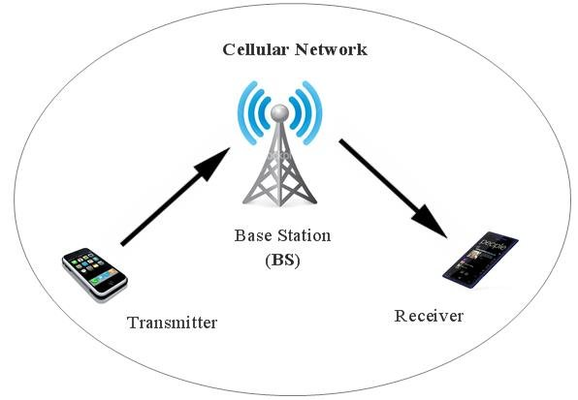
Operation of Cellular Systems
Base Station: A base station is a fixed point of communication for cellular phones on a carrier network.
The most important part of the cellular network is the base station.
It contain 3 elements
Antenna- handles ranging of signals
Controller- handles call process between mobile and network.
Transceivers- transmit and receives signals

Slide 29
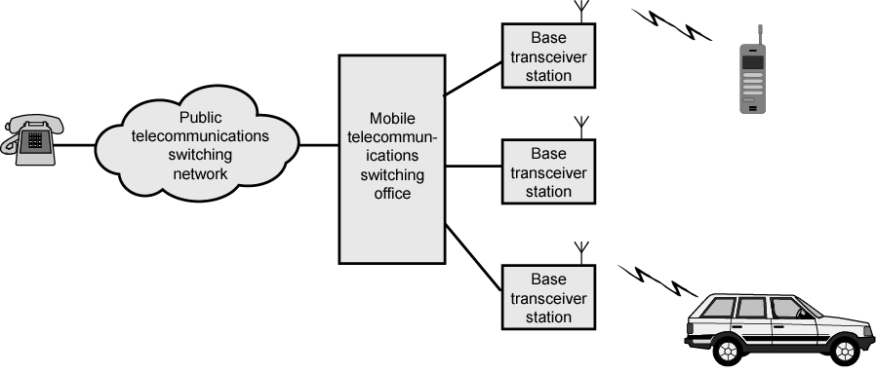
Operation of Cellular Systems
Each Base station is connected to a MTSO (Mobile Telecommunication Switching Office).
MTSO is also connected with PTSN (Public Telecommunications Switching Network).
MTSO
Connects calls between mobile units and from mobile to fixed telecommunications network
Assigns voice channel
Performs handoffs
Monitors calls (billing)

Slide 30
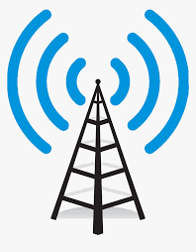
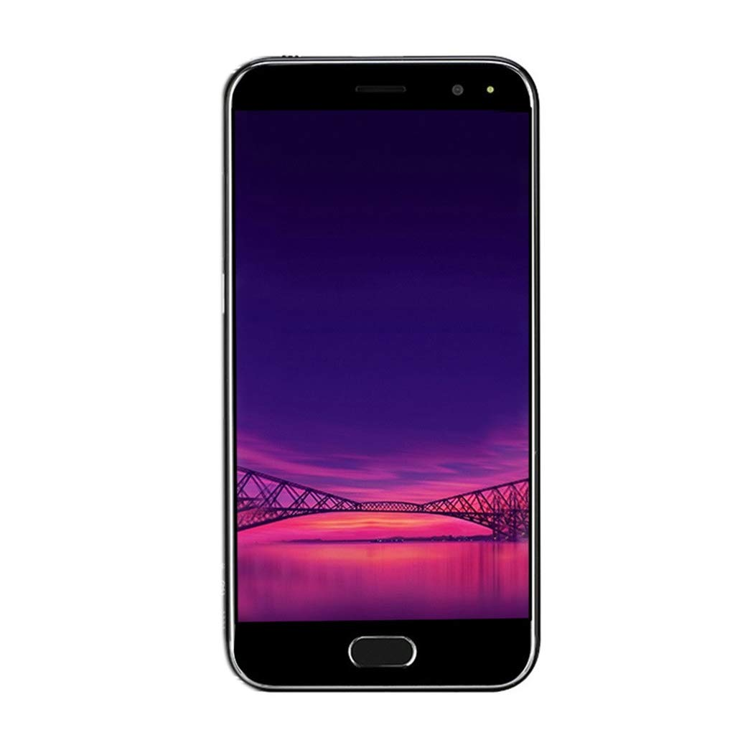
Cellular System
The Cellular System is fully automated except placing or answering the call.
Two types of channel available between
Contains information for setting up and maintaining calls, establish relationship between mobile unit and nearest Base Station
Control Channel
Traffic Channel
Base Station
Carry voice or data connections between users.
Mobile Unit

Slide 31
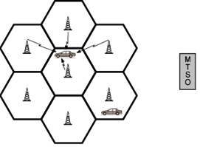
Typical Call in Single MTSO Area
Mobile unit initialization
When mobile is turns ON,
Scan and select strongest set up control channel
Automatically selected BS antenna of cell
Usually but not always nearest (propagation anomalies)
Handshake between MTSO and Mobile unit via base station(BS) to identify user and register location
Scan repeated to allow for movement
Change of cell
Mobile unit monitors for pages

Slide 32
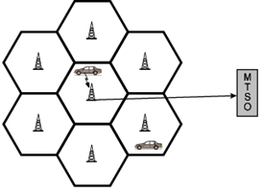
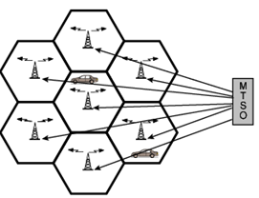
Typical Call in Single MTSO Area
Mobile originated call
Check set up channel is free
Monitor forward channel (from BS) and wait for idle
Send number on pre-selected channel
The BS will send request to MTSO
Paging
MTSO attempts to connect to mobile unit
Paging message sent to BSs depending on called mobile number
Paging signal transmitted on set up channel

Slide 33
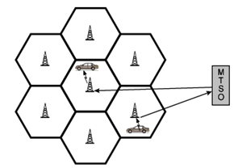
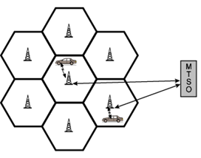
Typical Call in Single MTSO Area
Call accepted
Mobile unit recognizes number on set up channel
Responds to BS which sends response to MTSO
MTSO sets up circuit between calling and called BSs
MTSO selects available traffic channel within cells and notifies BSs
BSs notify mobile unit of channel
Ongoing call
Voice/data exchanged through respective BSs and MTSO

Slide 34
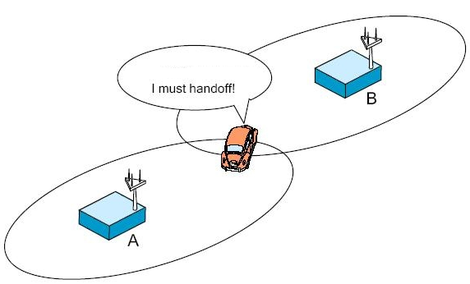
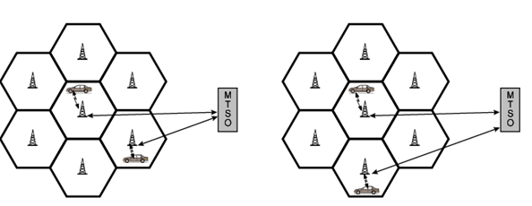
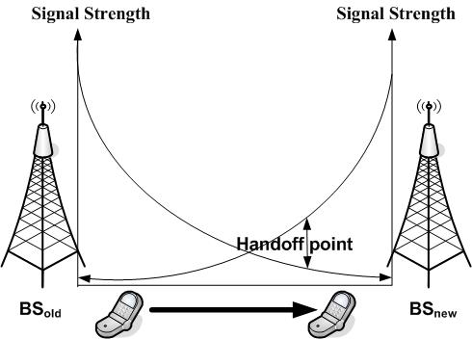
Typical Call in Single MTSO Area
Handoff
Mobile unit moves out of range of cell into range of another cell
Traffic channel changes to one assigned to new BS
Without interruption of service to user

Slide 35
Call in Single MTSO Area: Other Functions
Call blocking
During mobile-initiated call stage, if all traffic channels busy, mobile tries again
After number of fails, busy tone is returned
Call termination
User hangs up
MTSO informed
Traffic channels at two BSs released
Call drop
BS cannot maintain required signal strength
Traffic channel dropped and MTSO informed
Calls to/from fixed and remote mobile subscriber
MTSO connects to PSTN
MTSO can connect mobile user and fixed subscriber via PSTN
MTSO can connect to remote MTSO via PSTN or via dedicated lines
Can connect mobile user in its area and remote mobile user

Slide 36
Mobile Radio Propagation Effects

Slide 37
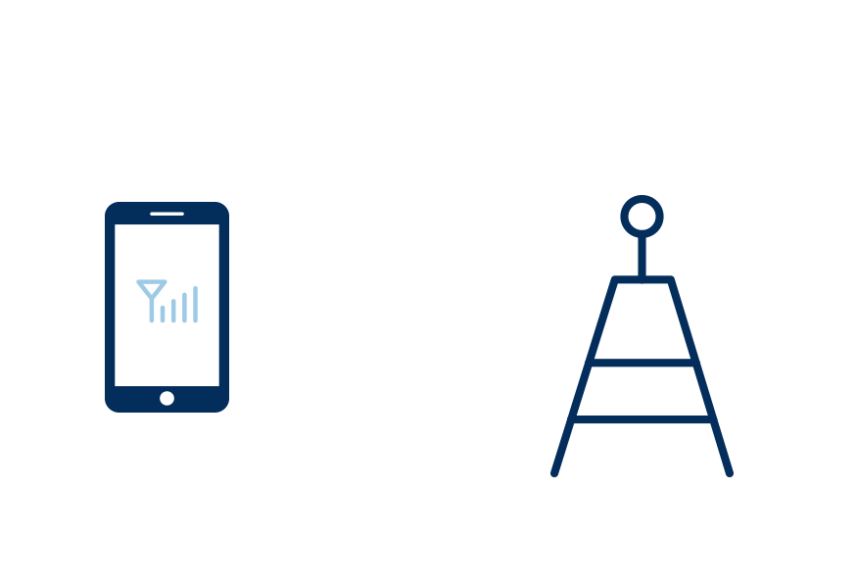
Mobile Radio Propagation Effects
Signal strength
Strength of signal between BS and mobile unit strong enough to maintain signal quality at the receiver
Not strong enough to create too much cochannel interference
Noise varies
Automobile ignition noise greater in city than in suburbs
Other signal sources vary
Signal strength varies as function of distance from BS
Signal strength varies dynamically as mobile unit moves

Slide 38
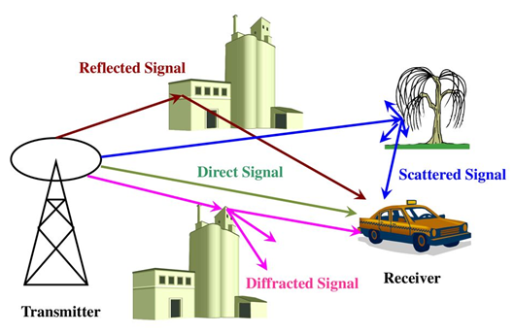
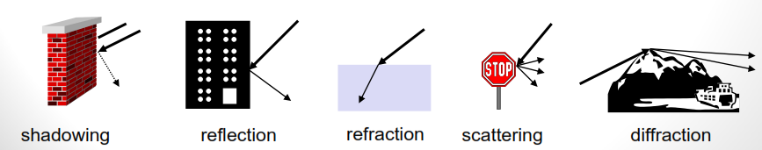
Mobile Radio Propagation Effects
Reflection:
Propagation wave impinges on an object which is large as compared to wavelength
May have phase shift from original
May cancel out original or increase it
E.g. surface of the Earth, buildings, walls, etc.
Diffraction
Radio path between transmitter and receiver obstructed by surface with sharp irregular edges
Waves bend around the obstacle, even when LOS (line of sight) does not exist
Scattering
Objects smaller than the wavelength of the propagation wave
e.g. foliage, street signs, lamp posts

Slide 39
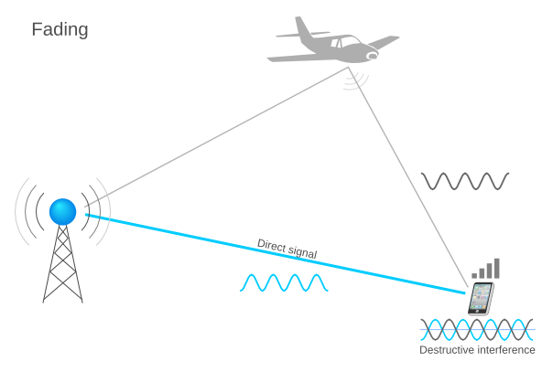
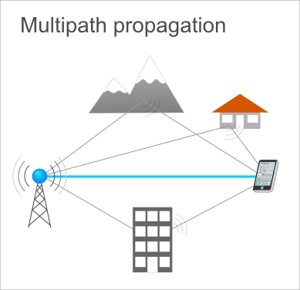
Mobile Radio Propagation Effects
Fading
In wireless communication signal fading occurs due to
Time variation of received signal
Caused by changes in transmission path(s)
Atmospheric conditions (rain)
Movement of (mobile unit) antenna
Multipath effect
It means signal travels from source may take multiple path to reach destination.
The signals receives at then receiver end is sum of all multipath signals.
It may leads to phase difference due to comparatively longer and shorter path of traversal in multipath effect.

Slide 40
Types of Fading

Slide 41
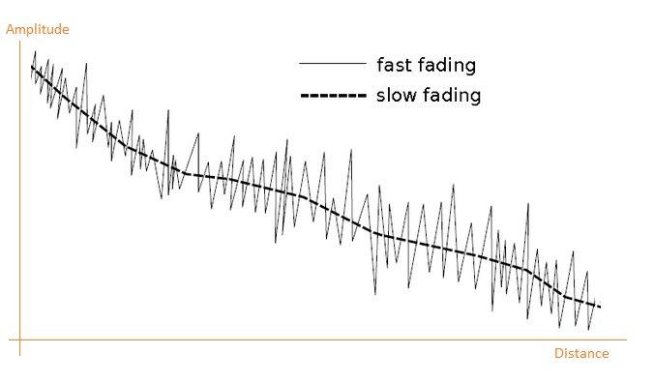
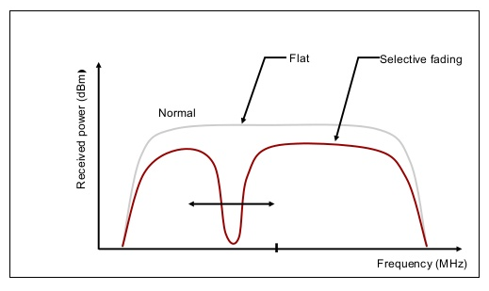
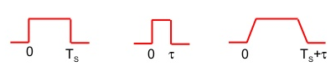
Types of Fading
Fast fading
Rapid changes in strength over distances about half wavelength
Slow fading
Slower changes due to user passing different height buildings, gaps in buildings etc.
Over longer distances than fast fading
Flat fading
Nonselective
Affects all frequencies in same proportion
Selective fading
Different frequency components affected differently

Slide 42
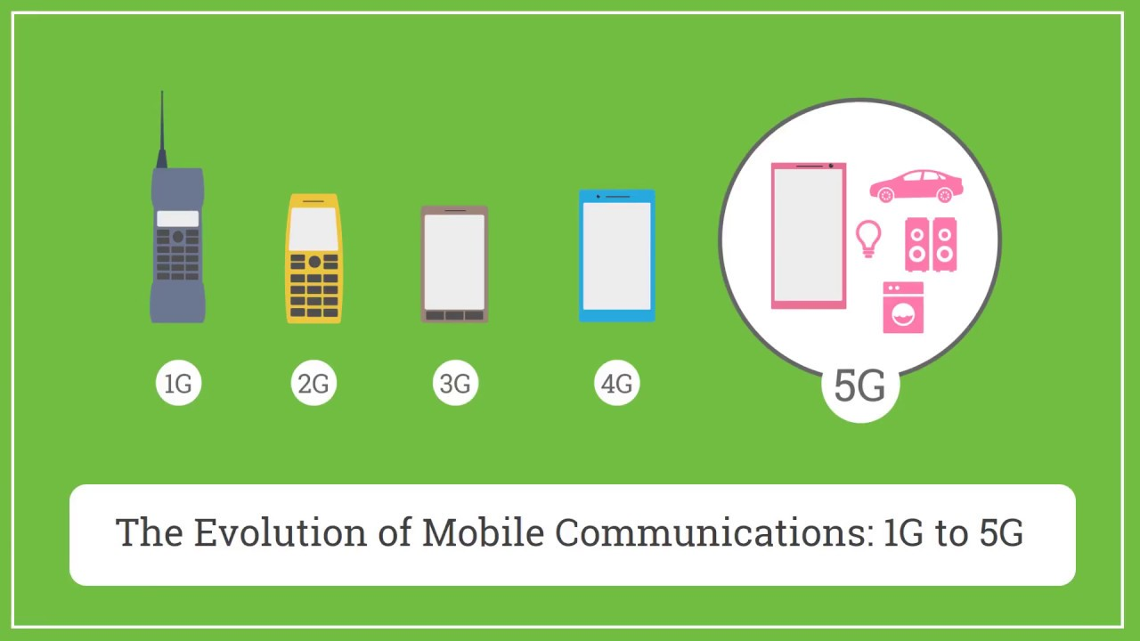

Slide 43
First Generation Analog

Slide 44

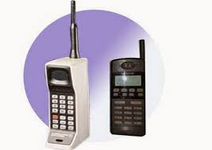

First Generation Analog
Refers to 1G (first generation of wireless cellular technology mobile telecommunications)
Uses analog radio signals
Provides basic voice service
Nippon Telephone and Telegraph (NTT) in Tokyo started the first commercial analog cellular system in December 1979
Transmission speed was very low (1-2Kbps).
Each phone contained
32-bit serial number
10 digit phone number in its PROM
The pivotal idea behind 1G Cellular network was that the geographical area is divided among cells
Each cell served by base station

Slide 45
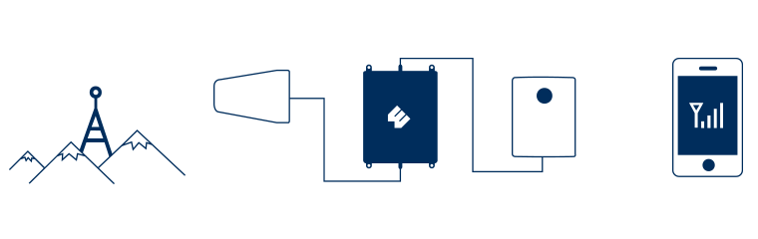
First Generation Analog: Call Sequence
Subscriber initiates call by keying in number and presses send
MTSO validates telephone number and checks user authorized to place call
Some service providers require a PIN to counter theft
MTSO issues message to user's phone indicating traffic channels to use
MTSO sends ringing signal to called party
All operations, 2 through 4, occur within 10s of initiating call
When called party answers, MTSO establishes circuit and initiates billing information
When one party hangs up MTSO releases circuit, frees radio channels, and completes billing information

Slide 46
First Generation Analog
Features
Channel Bandwidth: 30kHz
Data transmission rate: 1-2kbps
No. of control channel: 42
No. of voice channel: 790
Cell radius: 2-20km
Modulation-voice channel: FM (Frequency Modulation)
Modulation-control channel: FSK
Circuit switching
Limitations
Limited capacity:1-2kbps
Lack of privacy- No encryption
Poor sound quality
No room for spectrum growth
Unreliable hand-off
No internet

Slide 47
Second Generation -2G
TDMA & CDMA

Slide 48
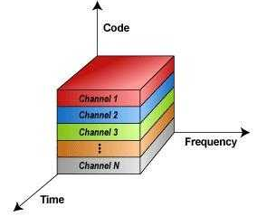
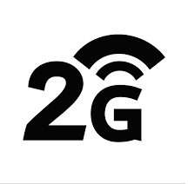
Second-Generation
Second Generation TDMA
(Time Division Multiple Access)
Second Generation CDMA
(Code Division Multiple Access)

Slide 49
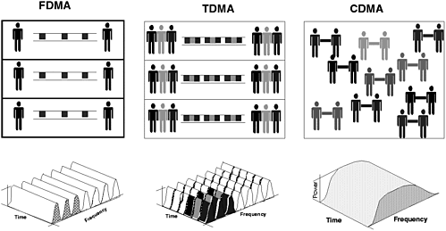
FDMA, TDMA, CDMA

Slide 50
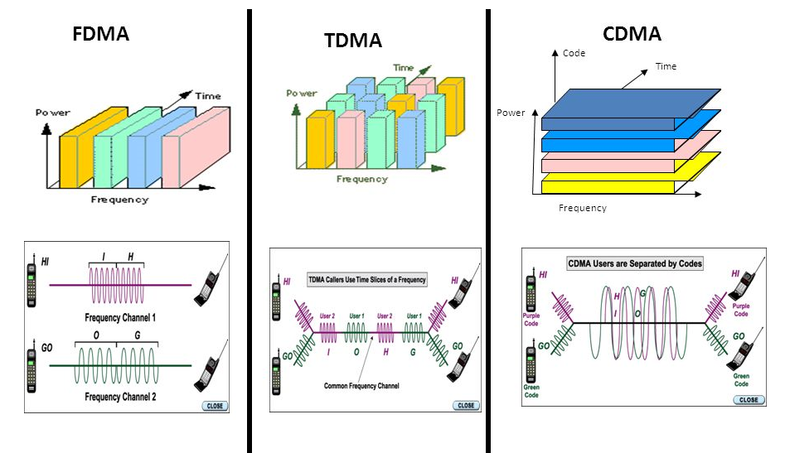

Slide 51

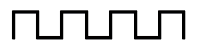
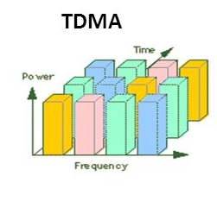
Second-Generation TDMA
It is a digital cellular telephone communication technology.
It facilitates many users to share the same frequency without interference.
TDMA technology divides a signal into various timeslots, and increases the data carrying capacity.
TDMA is used in digital mobile radio systems.
The individual mobile stations cyclically assign a frequency for the exclusive use of a time interval.

Slide 52
Second-Generation TDMA: Advantages and Disadvantages
Advantages
Flexible rates (i.e. several slots can be assigned to a user, for example, each time interval translates 32Kbps, a user is assigned two 64 Kbps slots per frame).
Can withstand with variable bit rate traffic.
Number of slots allocated to a user can be changed frame by frame (for example, two slots in the frame 1, three slots in the frame 2, one slot in the frame 3).
No guard band required for the wideband system.
No narrowband filter required for the wideband system.
Disadvantages
High data rates of broadband systems require complex equalization.
Call time is needed in each slot to accommodate time to inaccuracies (due to clock instability).
Electronics operating at high bit rates increase energy consumption.
Complex signal processing is required to synchronize within short slots.

Slide 53
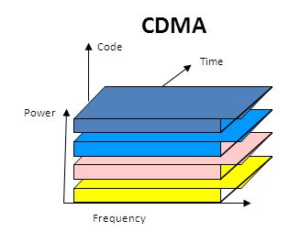
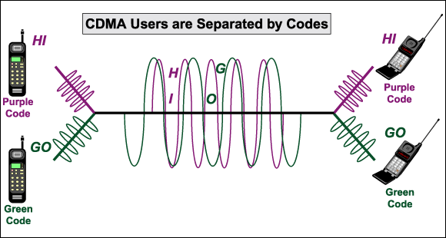
Second-Generation CDMA
In CDMA, each group of users is given a shared code.
Many codes occupy the same channel, but only those users associated with a particular code can communicate.
Every channel uses the full available spectrum.
Each conversations are encoded with a pseudo-random digital sequence and then transmitted using a wide frequency range.
Provides better voice quality and data communication.
Digital traffic channels
Support digital data
Voice traffic digitized
User traffic (data or digitized voice) converted to analog signal for transmission
Encryption
Simple to encrypt digital traffic
Error detection and correction
More capacity than TDMA

Slide 54
Second-Generation CDMA: Advantages and Disadvantages
Advantages
It does not require any synchronization
It has a very high spectral capacity, thus many numbers of users can share in the same bandwidth
CDMA channel is not easily decode-able
Dropouts occur only when the phone is at least twice as far from the base station.
High voice quality as well as signal quality
Flexible allocation of resources
Operate at a very low power level
Disadvantages
Does not provide international roaming capabilities like GSM.
Information related to CDMA is stored in phone memory rather than SIM memory like GSM, thus, tedious to upgrade Mobile unit.
Limited handset, because at present the major mobile companies use GSM technology.
Performance degrades with an increase in the number of users

Slide 55
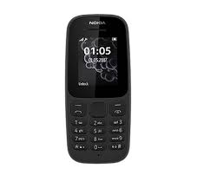
Second-Generation
Features
Emits comparatively less radio power
Maximum power drawn by mobile unit is 20Watts
Encryption facility
Error detection and correction
Internet was provided
Limitations
Difficult to handle complex data such as Video
Higher signal strength is required to make device work

Slide 56
Third Generation -3G

Slide 57
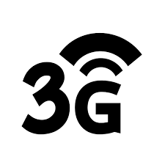
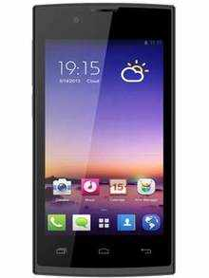
Third-Generation Systems
Introduced in year 2000
Used WCDMA (Wideband CDMA) technology
Support circuit and packet switching
Objective is to provide fairly high-speed wireless communications to support
Multimedia data
Video
Voice
Web browsing
TV streaming
Video conferencing
Navigation
Email
More coverage with lowest investment

Slide 58
Third-Generation Systems
Features
Technology used: WCDMA/CDMA
Bandwidth: 5-10 Mbps
Frequency Band:15-25 GHz
User circuit and packet switching
Higher Security
Limitations
Cost of mobile unit is higher
Cost of 3G license services is higher.

Slide 59
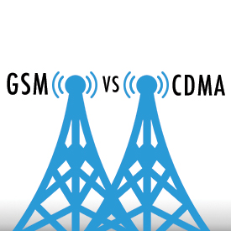
GSM vs CDMA

Slide 60
GSM vs CDMA
GSM | CDMA
Global System for Mobile communication | Code Division Multiple Access
Technology: FDMA & TDMA | CDMA
Data rate: 42Mbps in HSPA (3G) | Data rate: 3.6Mbps in CDMA
GSM supports transmitting data and voice together | CDMA doesn’t support it
Here customer information is stored in SIM card. | Here customer information is stored in Handset.
Global market share is 75% | Global market share is 25%
SIM specific. User can use/upgrade to multiple handset | Handset specific
Security is comparatively lower than CDMA | Provides more security as encryption is inherit feature
Support International roaming | CDMA doesn’t support this facility

Slide 61
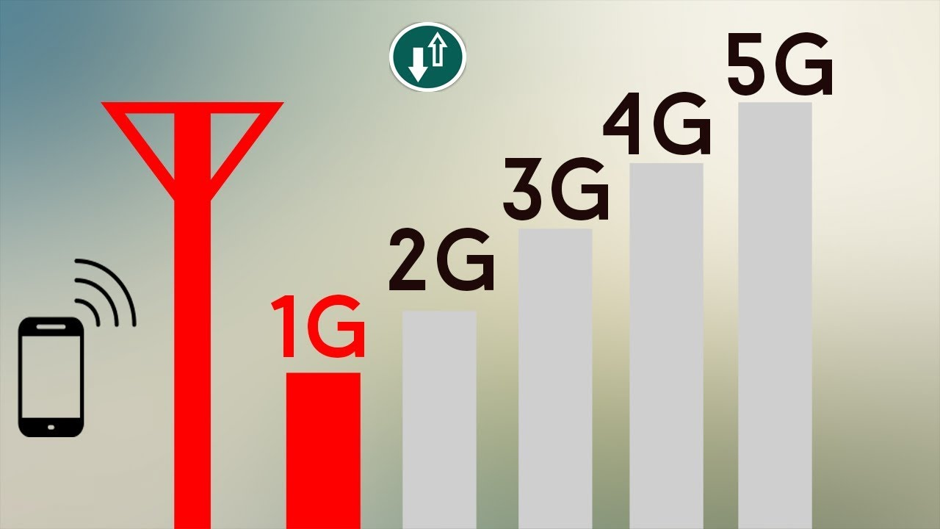
Comparison of Mobile Generations

Slide 62
Comparison of Mobile Generations
Parameters | 1G | 2G | 3G | 4G | 5G
Introduced in | 1980’s | 1990’s | 2000’s | 2010’s | 2020’s
Bandwidth | 2kbps | 64kbps | 2Mbps | 200Mbps | 1Gbps
Standard- Technology | AMPS-analog NMT-Nordic Mobile Telephone | TDMA,CDMA(2G) EDGE,GPRS(2.5G) GSM-digital cellular | 3G,HSPA,HSPA+ WCDMA-broadband UMTS | 4G,LTE Standard-Unified IP | Single Unified Standard-Unified IP Seamless
Switching Technique | Circuit Switching | Circuit Switching & Packet Switching | Packet Switching | Packet Switching | Packet Switching
Multiplexing Technique | FDMA | TDMA/CDMA | CDMA | CDMA | CDMA
Core Network | PSTN | PSTN | Packet Network | Internet | Internet
Features | Mobility, voice call | Roaming Voice quality SMS,MMS | Global Roaming, High speed data Internet(limited) | Internet, MobileIP, Wi-Max | Internet <1 msec latency IoT
Handoff | Horizontal | Horizontal | Horizontal | Horizontal & Vertical | Horizontal & Vertical

Slide 63
GTU Questions: Unit 2-Part 1
Sr. | Question | Marks | Year
1. | Describe Cell Splitting and Cell Sectoring with its limitations in detail. | 7 | Win’19
2. | Justify, Why Hexagon cell shape is used in cellular network? | 3 | Win’20
3. | Define following.1) Fading 2) Modulation | 3 | Win’18
4. | Define Reflection, Refraction and diffraction. | 4 | Sum’19

Slide 64

References
Book: | Wireless Communications & Networks, Second Edition, William Stallings by Pearson

Slide 65
Thank You

